Slide 1
Processor Peripherals
Third Laboratory Session
Prof. Claudio Passerone
(Electronics for Embedded Systems)

Slide 2
Introduction
Processor Peripherals – Third Laboratory Session
Manage UART transmissions using a hardware peripheral
  Use the UART peripheral of the Nios II processor
  VHDL code provided by the instructor
    The same as the second laboratory session
  Assignment: write software to
    Configure the UART peripheral
    Send characters over UART to a terminal emulator
    Receive characters over UART from a terminal emulator
  Hardware implementation gives several advantages
    Higher performance
      Easily reach 115200 baud rate
    Simplified software on the processor
      Three lines of code to read a character
    More time available for the processor core to perform other tasks

Slide 3
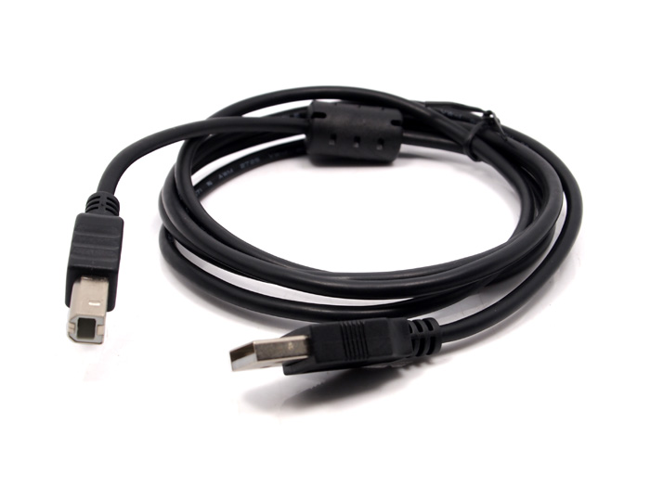
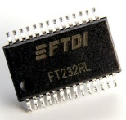

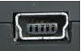
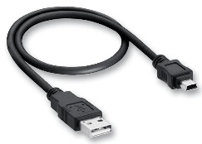
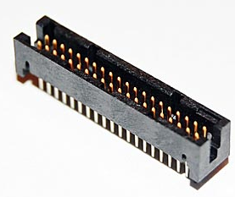
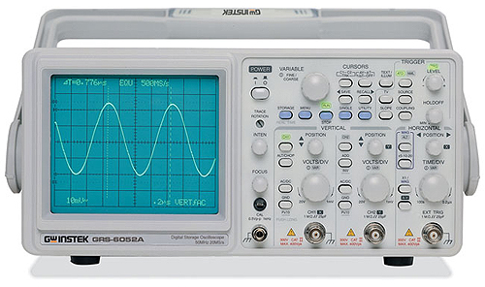
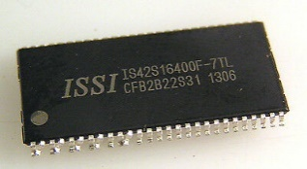
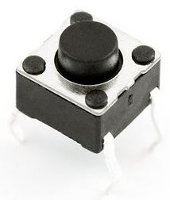
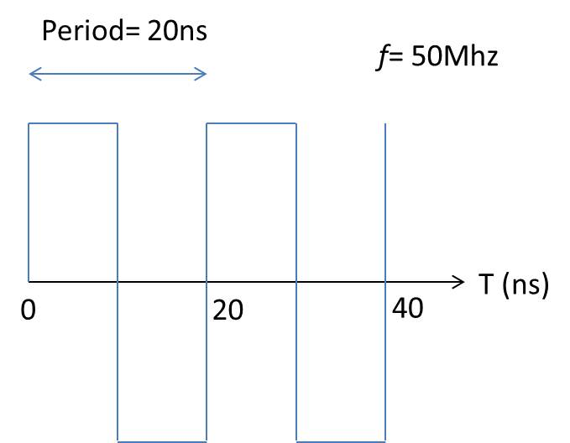
Hardware Project
Processor Peripherals – Third Laboratory Session
SoC components
  Nios II processor
  core
  JTAG_UART (to
  manage stdout)
  UART peripheral
  Output GPIOs (to
  drive the header
  connector)
  SDRAM Controller
  Timer (not used to
  perform UART
  transfers)
DE1-SoC Board
USB Blaster Cable
NiosII
Processor
Core
JTAG UART
(debug)
stdout
USB to UART
Timer
UART
uartrx
HPS_UART_RX
uarttx
USB mini cable
HPS_UART_TX
SDRAM
Controller
(64 Mbyte)
OUT GPIOs
GPIO_0
USB mini connector
GPIO_1
PC with terminal emulator and running Quartus Prime
Entity generated
by Platform Designer
Top level entity on Cyclone V FPGA
40 pin header connectors
reset
clock
50 MHz quartz
Oscilloscope

Slide 4
Hardware Project
Processor Peripherals – Third Laboratory Session
The full HW project also includes
  PLL to generate clocks
    For the Nios II processor
    For the external 64 Mbyte SDRAM
  ARM9 processor
    With a microSD Card to bootstrap it…
    … and forward UART lines to the FPGA fabric (and the UART peripheral of the Nios II processor)
    Same microSD Card as in the second laboratory session
  Several GPIOs to manage
    LEDs, switches and buttons
    Seven segment displays
  Other peripherals
    I2C, SPI
      Don’t use, reserved for future students

Slide 5
Hardware Project
Processor Peripherals – Third Laboratory Session
USB to UART
1-bit IN GPIO
uartrx
HPS_UART_RX
HW Project implementation
  Download the zip file
    Identical to the second laboratory session project
  Uncompress it in some folder
    Where you have write permission
    Without any space or parenthesis in the full path
  Insert the microSD Card in the Card Reader
  of the DE1-Soc Board
  Open the HW project with Quartus Prime
    You don’t have to recompile it
    Program the board using the programmer
  Put SW9 (the left most switch) on the 1 position
    Towards the red LED9
    In the 0 position it is like the second laboratory session
GPIO_0
USB mini connector
1
0
40 pin header connectors
SW9
USB to UART
UART
uartrx
HPS_UART_RX
uarttx
HPS_UART_TX
GPIO_0
USB mini connector
1
0
40 pin header connectors
SW9

Slide 6
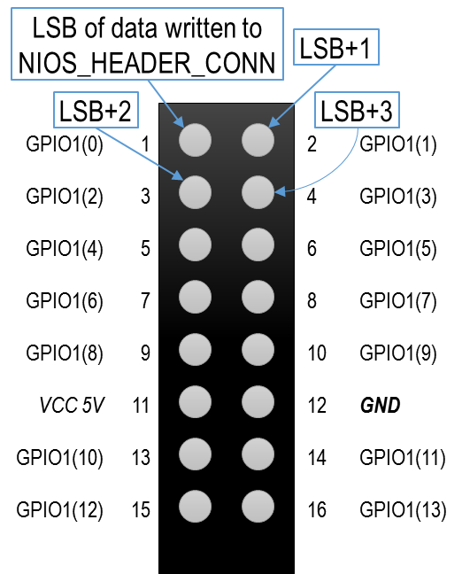
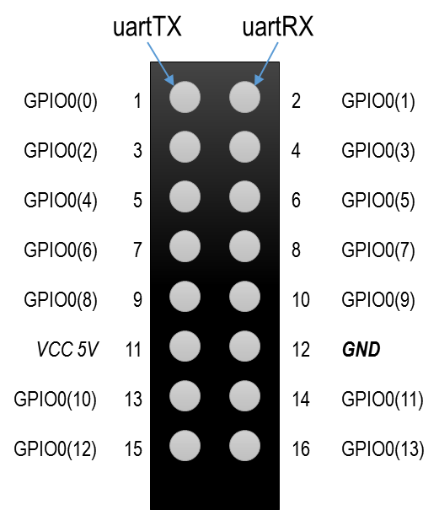
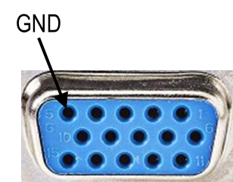
Hardware Project
Processor Peripherals – Third Laboratory Session
Connections on the DE1-SoC
  USB type A Host-to-Device cable for JTAG
    Programming the hardware
    Downloading the software
    Implement stdin and stdout over JTAG
  USB mini cable for UART connection
    Using the FDTI232R integrated circuit
  Female/Male jumpers for the oscilloscope
    To display UART RX and TX signals
      On the left header connector
    To display software controlled pins
      On the right header connector
  Power Supply

Slide 7
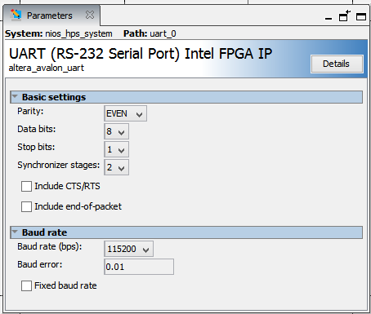
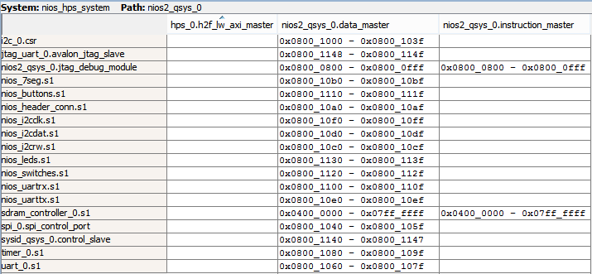
Altera Nios II UART Peripheral
Processor Peripherals – Third Laboratory Session
Instantiated in Platform Designer
  Simple UART peripheral
    No support for FIFOs
  115200, 8E1
  Baud Rate configurable at run-time
  Parity, Data bits and Stop bits
  fixed at generation time
  Base address and range
    0x08001060 – 0x0800107f
    Range is 32 bytes
Memory map
64 MByte

Slide 8
Altera Nios II UART Peripheral
Processor Peripherals – Third Laboratory Session
Sending a character
  Processor writes a character to the TXDATA register
    First checks if TXDATA register is ready (TRDY)
  UART Peripheral actions
    Mark TXDATA register as full (TRDY = 0)
      If already full, report overrun (TOE = 1)
    If there are no ongoing transmissions
      Transfer character to the TX Shift Register
        Mark TXDATA register as ready (TRDY = 1)
      Start UART transmission on serial TX line
    If there is an ongoing transmission
      Wait for the transmission to terminate
      Transfer character to the TX Shift Register
        Mark TXDATA register as ready (TRDY = 1)
      Start UART transmission on serial TX line
Address
divisor
Clock gen
RXD
Data
rxdata
rx shift reg
Control
status
FDTI232R
TXD
IRQ
txdata
tx shift reg
clock
control
The µP core writes the txdata register. The tx shift reg is loaded from txdata automatically when a serial transmit shift operation is not currently in progress. The tx shift reg directly feeds the TXD output. Data is shifted out to TXD LSB first.
These two registers provide double buffering. A master can write a new value into txdata while the previously written character is being shifted out. The master can monitor the transmitter's status by reading the status register's transmitter ready (TRDY), transmitter shift register empty (tmt), and transmitter overrun error (TOE) bits.
The transmitter logic automatically inserts the correct number of start, stop, and
parity bits in the serial TXD data stream as required by the RS-232 specification.

Slide 9
Altera Nios II UART Peripheral
Processor Peripherals – Third Laboratory Session
Receiving a character
  Data arrives on serial RX line
    It fills the RX shift register
  UART Peripheral actions (after the STOP bit)
    Decode UART frame in the RX shift register
    Transfer character to the RXDATA register
      Mark RXDATA register as ready (RRDY = 1)
      If already ready, report overrun (ROE = 1)
  Processor actions
    Test RRDY for data available
      Also check for errors (ROE)
    If ready, read the character from the RXDATA register
  UART Peripheral further action
    Mark RXDATA register as empty (RRDY = 0)
Address
divisor
Clock gen
RXD
Data
rxdata
rx shift reg
Control
status
FDTI232R
TXD
IRQ
txdata
tx shift reg
clock
control
The µP core reads the rxdata register. The rxdata register is loaded from the rx shift reg automatically every time a new character is fully received.
These two registers provide double buffering. The rxdata can hold a previously received character while the subsequent character is being shifted into rx shift reg.
A master can monitor the receiver's status by reading the status register's read-ready (RRDY), receiver-overrun error (ROE), break detect (BRK), parity error (PE), and framing error (FE) bits. The receiver logic automatically detects the correct number of start, stop, and parity bits in the serial RXD stream as required by the RS-232 specification. The receiver logic checks for four exceptional conditions, frame error, parity error, receive overrun error, and break, in the received data and sets corresponding status register bits.

Slide 10
Altera Nios II UART Peripheral
Processor Peripherals – Third Laboratory Session
Peripheral registers
  RXDATA: Receive Data register
  TXDATA: Transmit Data register
  STATUS: Status register
  CONTROL: Control register
  DIVISOR: Baud Rate Divisor register
Offset | Register Name | R/W | Description / Register Bits
 |  |  | 15:13 | 12 | 11 | 10 | 9 | 8 | 7 | 6 | 5 | 4 | 3 | 2 | 1 | 0
0 | rxdata | RO | Reserved |  |  |  |  |  | Receive Data
1 | txdata | WO | Reserved |  |  |  |  |  | Transmit Data
2 | status | RW | Reserved | eop | cts | dcts |  | e | rrdy | trdy | tmt | toe | roe | brk | fe | pe
3 | control | RW | Reserved | ieop | rts | idcts | tbrk | ie | irrdy | itrdy | itmt | itoe | iroe | ibrk | ife | ipe
4 | divisor | RW | Baud Rate Divisor
Register | Address
rxdata | 0x08001060
txdata | 0x08001064
status | 0x08001068
control | 0x0800106C
divisor | 0x08001070

Slide 11
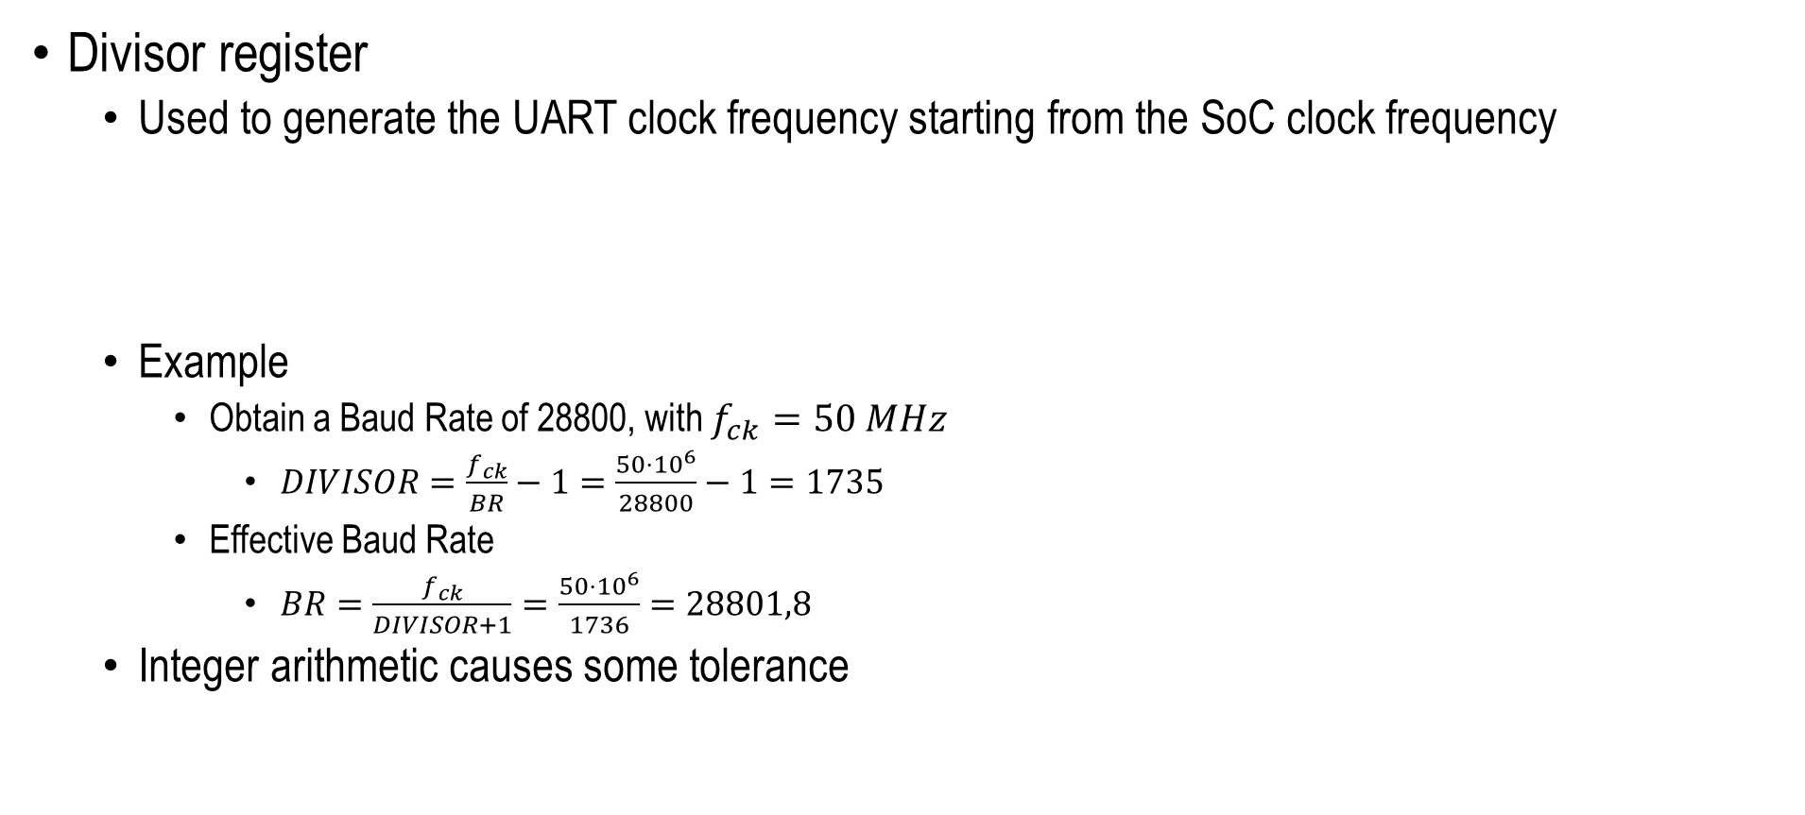
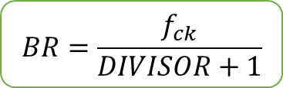

Altera Nios II UART Peripheral
Processor Peripherals – Third Laboratory Session
Divisor register
  Used to generate the UART clock frequency starting from the SoC clock frequency
  Example
    Obtain a Baud Rate of 28800, with $f_{ck}=50 MHz$
      $DIVISOR=\frac{f_{ck}}{BR}−1=\frac{50⋅{10}^{6}}{28800}−1=1735$
    Effective Baud Rate
      $BR=\frac{f_{ck}}{DIVISOR+1}=\frac{50⋅{10}^{6}}{1736}=28801,8$
  Integer arithmetic causes some tolerance
$$DIVISOR=\frac{f_{ck}}{BR}−1$$
$$BR=\frac{f_{ck}}{DIVISOR+1}$$

Slide 12
Altera Nios II UART Peripheral
Processor Peripherals – Third Laboratory Session
Status register
Bit | Name | Full Name | Description
0 | PE | Parity Error | Set to 1 when parity error is detected. Should be cleared by the processor.
1 | FE | Frame Error | Set to 1 when the STOP bit was not detected correctly. Should be cleared by the processor.
2 | BRK | Break Error | Set to 1 when break is detected (line at 0 for more than a frame duration). Should be cleared by the processor.
3 | ROE | Receive Overrun Error | Set to 1 when new data is received before previous data in the RXDATA register was read. Should be cleared by the processor.
4 | TOE | Transmit Overrun Error | Set to 1 when new data is written to the TXDATA register before the previous data is transferred to the TX shift register. Should be cleared by the processor.
5 | TMT | Transmit Empty | Set to 1 when the TX shift register is empty (i.e. the transmit path is idle), otherwise it is 0.
6 | TRDY | Transmit Ready | Set to 1 when the TXDATA register is ready to receive a new character, otherwise it is 0.
7 | RRDY | Receive Ready | Set to 1 when new data is available in the RXDATA register. Set to 0 when RXDATA is read.
8 | E | Error | Set to 1 when any of the errors occur. Should be cleared by the processor.

Slide 13
Altera Nios II UART Peripheral
Processor Peripherals – Third Laboratory Session
Control register
Bit | Name | Full Name | Description
0 | IPE | Interrupt on Parity Error | Enable interrupt generation on parity error.
1 | IFE | Interrupt on Frame Error | Enable interrupt generation on frame error.
2 | IBRK | Interrupt on Break Error | Enable interrupt generation on break detection.
3 | IROE | Interrupt on Receive Overrun Error | Enable interrupt generation on receive overrun error.
4 | ITOE | Interrupt on Transmit Overrun Error | Enable interrupt generation on transmit overrun error.
5 | ITMT | Interrupt on Transmit Empty | Enable interrupt generation on transmit empty.
6 | ITRDY | Interrupt on Transmit Ready | Enable interrupt generation on transmit ready.
7 | IRRDY | Interrupt on Receive Ready | Enable interrupt generation on receive ready.
8 | IE | Interrupt on Error | Enable interrupt generation on error.

Slide 14
Software Project
Processor Peripherals – Third Laboratory Session
Use the Nios II Software Build Tools for Eclipse
  Like in the second laboratory session
Write main() function
  Altera library takes care of initializing the Nios II processor
Include header files
Use macros to make your code more general
#include <stdio.h>
#include "system.h"
#include "sys/alt_timestamp.h"
#include "altera_avalon_pio_regs.h"

Slide 15
Software Project
Processor Peripherals – Third Laboratory Session
Read a register
  You may want to mask unused bits of the integer variable
    If the register is not on 32 bits
You can also use pointers to void
  But beware of pointer arithmetic
    It differs between integer and void pointers
    It depends on the type size
int *p = (int *) UART_0_BASE;
int regoffset = … ;
int reg;
reg = *(p + regoffset);
reg = reg & 0x000000ff;

Slide 16








































Software Project
Processor Peripherals – Third Laboratory Session
Read a bit in a register
  Use a mask to isolate a single bit
    Or multiple bits, if needed
    AND Boolean function sets all other bits to 0
  Shift the isolated bit to the LSB
    No need to shift if only testing if different from 0
reg
$$0$$
$$0$$
$$0$$
$$0$$
$$0$$
$$0$$
$$0$$
$$1$$
$$b_{7}$$
$$b_{6}$$
$$b_{5}$$
$$b_{4}$$
$$b_{3}$$
$$b_{2}$$
$$b_{1}$$
$$b_{0}$$
<< 5
&
$$0$$
$$0$$
$$1$$
$$0$$
$$0$$
$$0$$
$$0$$
$$0$$
=
$$0$$
$$0$$
$$b_{5}$$
$$0$$
$$0$$
$$0$$
$$0$$
$$0$$
int *p = (int *) UART_0_BASE;
int regoffset = … ;
int bitoffset = … ;
int reg;
int bit;
reg = *(p + regoffset);
bit = (reg & (1 << bitoffset)) >> bitoffset;
>> 5
$$0$$
$$0$$
$$0$$
$$0$$
$$0$$
$$0$$
$$0$$
$$b_{5}$$
bit

Slide 17
Software Project
Processor Peripherals – Third Laboratory Session
Write a register
You can also use pointers to void
  But beware of pointer arithmetic
    It differs between integer and void pointers
    It depends on the type size
// Write absolute value
int *p = (int *) UART_0_BASE;
int regoffset = … ;
int reg;
reg = … ;
*(p + regoffset) = reg;
// Read / Modify / Write
int *p = (int *) UART_0_BASE;
int regoffset = … ;
int reg;
reg = *(p + regoffset);
reg = reg + 1;
*(p + regoffset) = reg;
// Shadow register (global)
int shadowreg;
// Inside a function
int *p = (int *) UART_0_BASE;
int regoffset = … ;
shadowreg = … ;
*(p + regoffset) = shadowreg;
// Some code here
shadowreg = shadowreg + 1;
*(p + regoffset) = shadowreg;

Slide 18
Software Project
Processor Peripherals – Third Laboratory Session
Update a bit in a register
  Without modifying other bits in the register
  Shifting and masking
    AND with 0 to set it to 0
    OR with 1 to set it to 1
// Shadow register (global)
int shadowreg;
// Inside a function
int *p = (int *) UART_0_BASE;
int regoffset = … ;
int bitoffset = … ;
int bit;
shadowreg = … ;
*(p + regoffset) = shadowreg;
// Some code here
bit = … ;
if (bit == 0) shadowreg = shadowreg & (~(1 << bitoffset));
else shadowreg = shadowreg | (1 << bitoffset);
*(p + regoffset) = shadowreg;
// Read / Modify / Write
int *p = (int *) UART_0_BASE;
int regoffset = … ;
int bitoffset = … ;
int reg, bit;
bit = … ;
reg = *(p + regoffset);
if (bit == 0) reg = reg & (~(1 << bitoffset));
else reg = reg | (1 << bitoffset);
*(p + regoffset) = reg;

Slide 19
Software Project
Processor Peripherals – Third Laboratory Session
Drive the right header connector
  Set top-left pin to logic 1
    IOWR_ALTERA_AVALON_PIO_DATA(NIOS_HEADER_CONN_BASE, 1);
  Set top-left pin to logic 0
    IOWR_ALTERA_AVALON_PIO_DATA(NIOS_HEADER_CONN_BASE, 0);
  Set multiple pins
    pin₁ = 0, pin₂ = 1, pin₃ = 1, pin₄ = 0, pin₅ = 1, pin₆ = 0, pin₇ = 1, pin₈ = 1
    11010110₂ = D6₁₆ = 214₁₀
int value = 214;
IOWR_ALTERA_AVALON_PIO_DATA(NIOS_HEADER_CONN_BASE, value);
int *head_conn_base_p = (int *) NIOS_HEADER_CONN_BASE;
int datareg_offset = 0;
int value = 214;
*(head_conn_base_p + datareg_offset) = value;

